Slide 1
Lugless Launch Towers
Preferred Design Ideas and Mood-board
sourced from various contributors on The Rocketry Forum

Slide 2
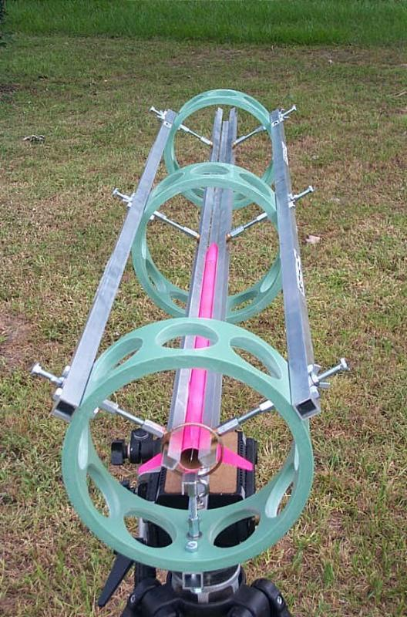
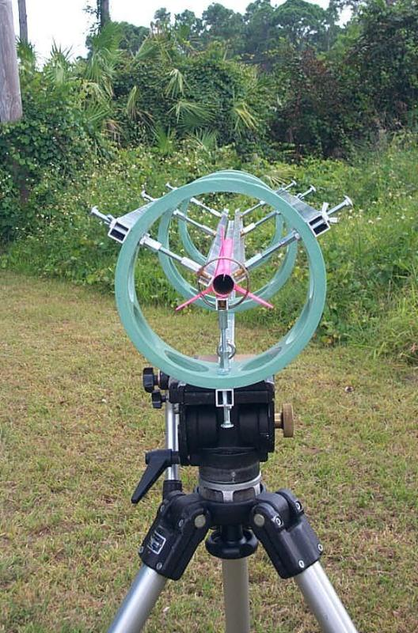
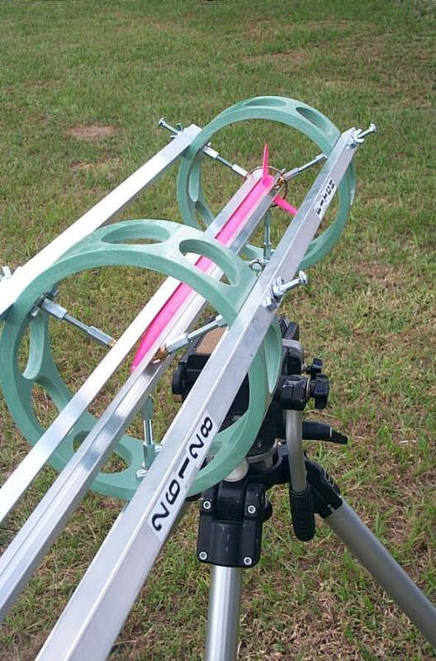

Slide 3
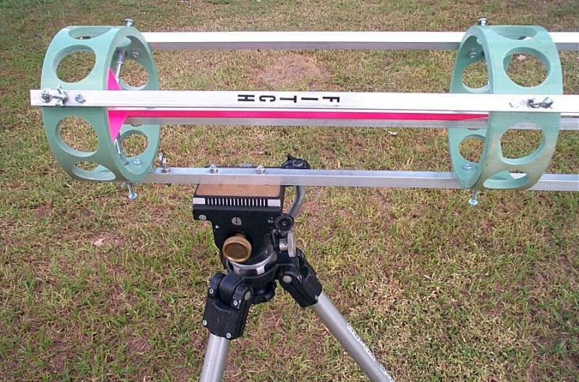
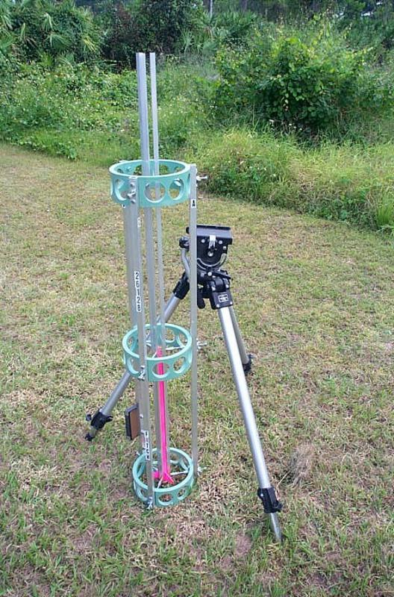
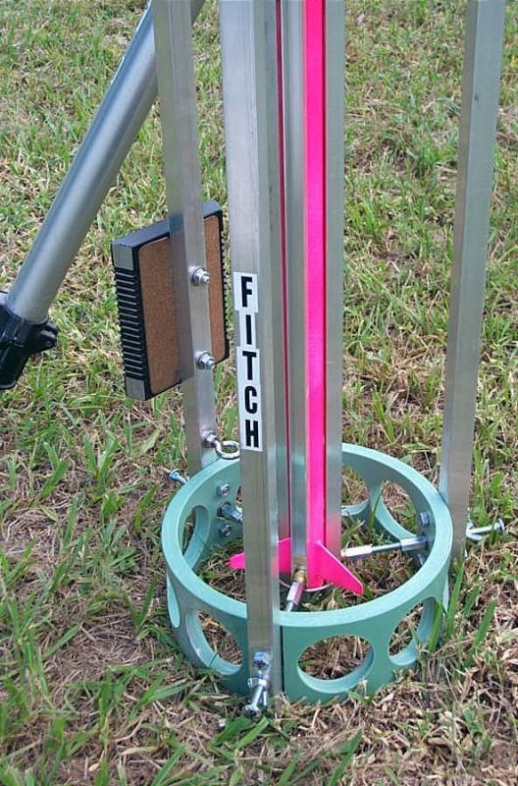


Slide 4
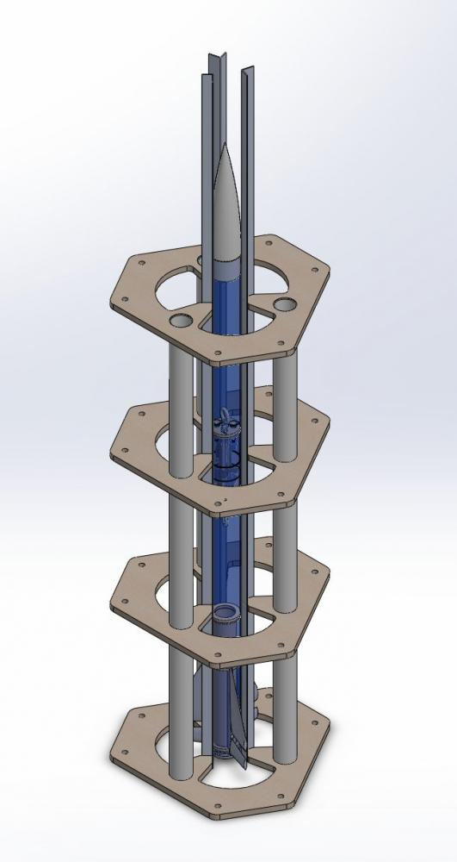
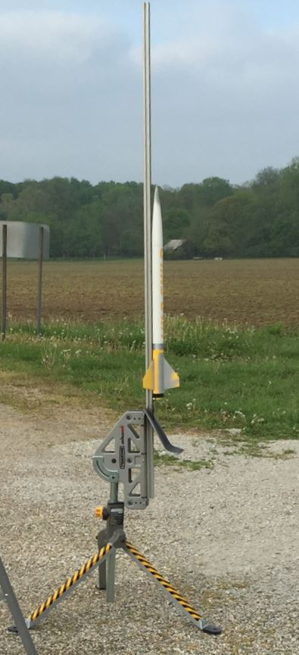
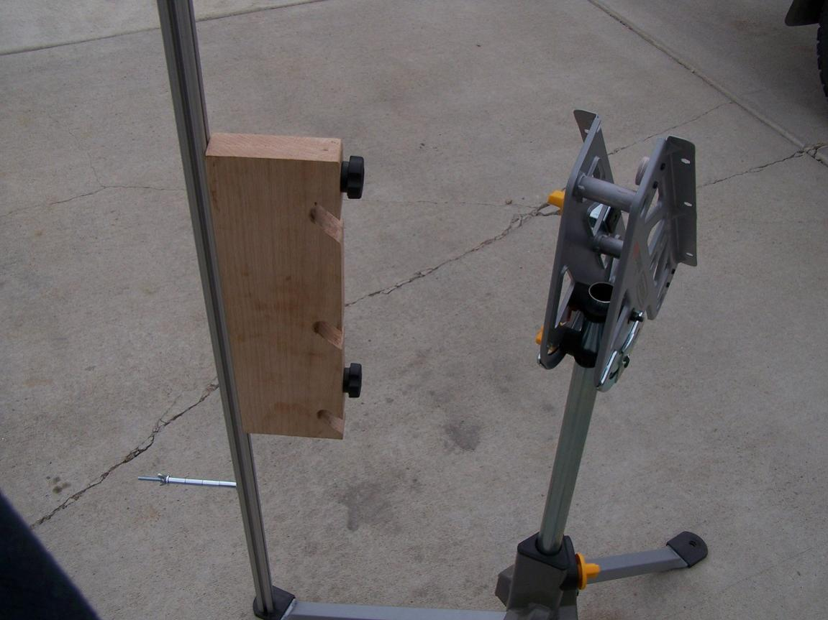
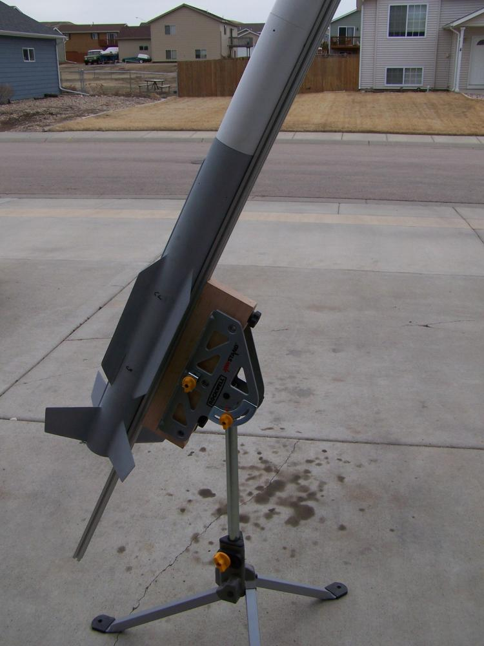
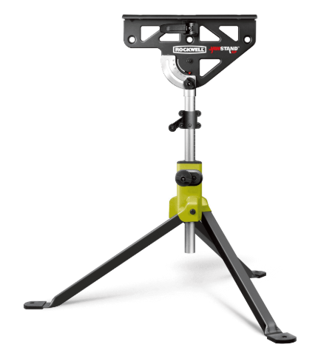

Suggested modifications:
Use servo motors to make rapid diameter adjustments.
Servos could sit on the lower three support frames independent of the three main stiffening structural tubes
Alignment tracks/channels for the servo slots to stop them drifting left or right just in/out.
Add a raised 3 legged base or use a Rockwell Jawstand for tilting down for ease of loading.
Add a blast plate/deflector.

Slide 5
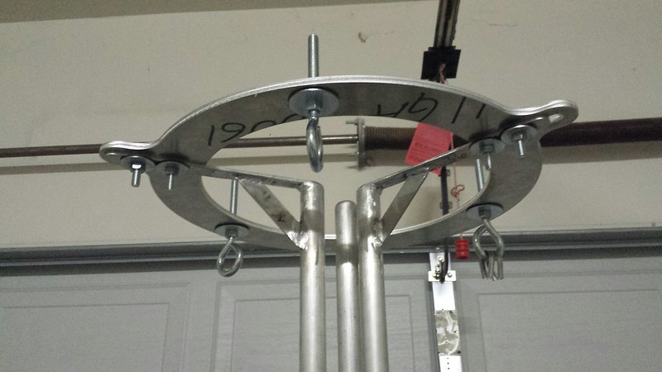
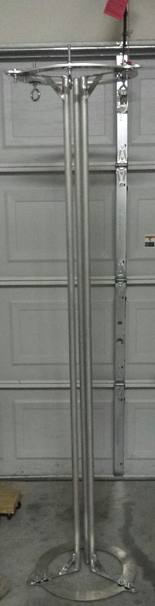
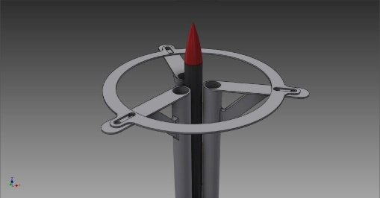
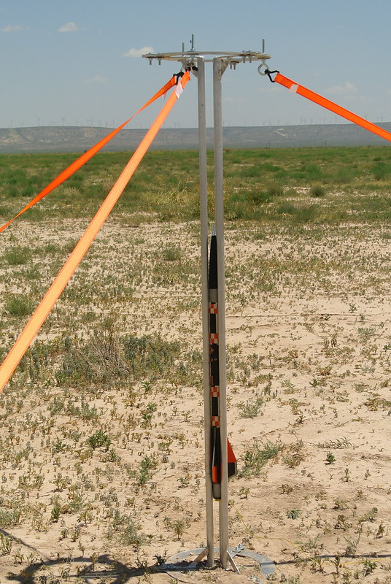
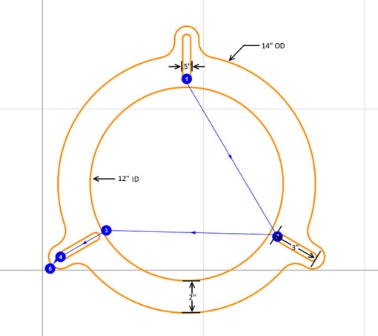
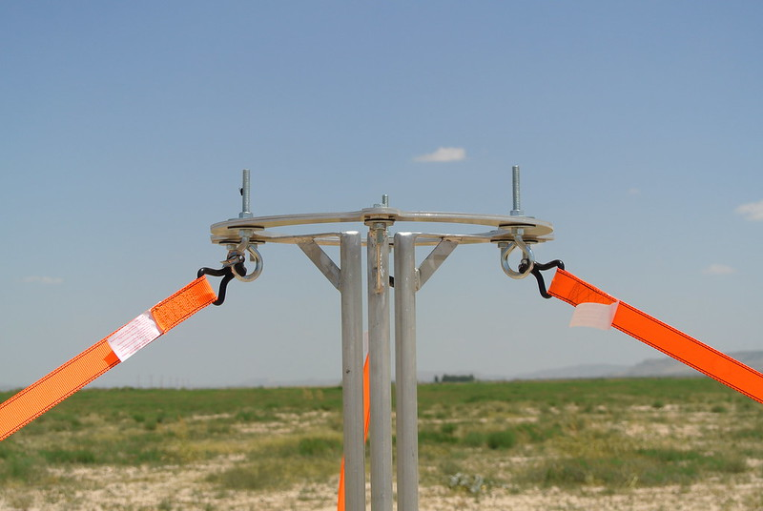
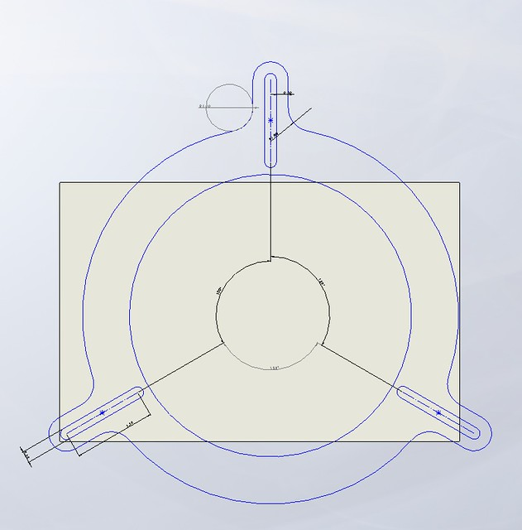
https://www.rocketryforum.com/threads/versatility-adjustable-launch-tower.67902/
Suggested modifications:
Alignment tracks/channels for the slots to stop them drifting left or right just in/out.
Raised 30cm legs/base. Will also help bottom ring adjustment.
Blast plate/deflector.
Hinged gate in one rail for easy rocket insertion?
Bottom stop for rocket to rest on.

Slide 6
